Slide 1
Ben & Jerry’s PA Outreach Strategy
June 2021

Slide 2
Question
Ben & Jerry’s is releasing a new flavor of ice cream specific to the Pennsylvania market called Keystone Crunch.
We want to know where Wawa may have the best opportunity for growth to win the Ben & Jerry’s contract to sell Keystone Crunch.

Slide 3
Analysis
We need to determine:
Where Wawa should keep the status quo
Where Wawa should try to compete with Sheetz in its outreach strategy
Where Wawa should stop competing with Sheetz in outreach and re-allocate resources to increase sales

Slide 4
Choices
Option 1: “Trim” — cut off marketing resources and operations in the West and Central regions of PA and re-allocate to pursue customers in the more populous Northeast and “Dutch” regions
Option 2: “Trial period” – cut off marketing resources and operations in the Central region, keep West in place and have a trial period of a certain length to see if there is a potential for growth in the West region
Note: for the purposes of this presentation, assume Wawa operates two stores in each county

Slide 5
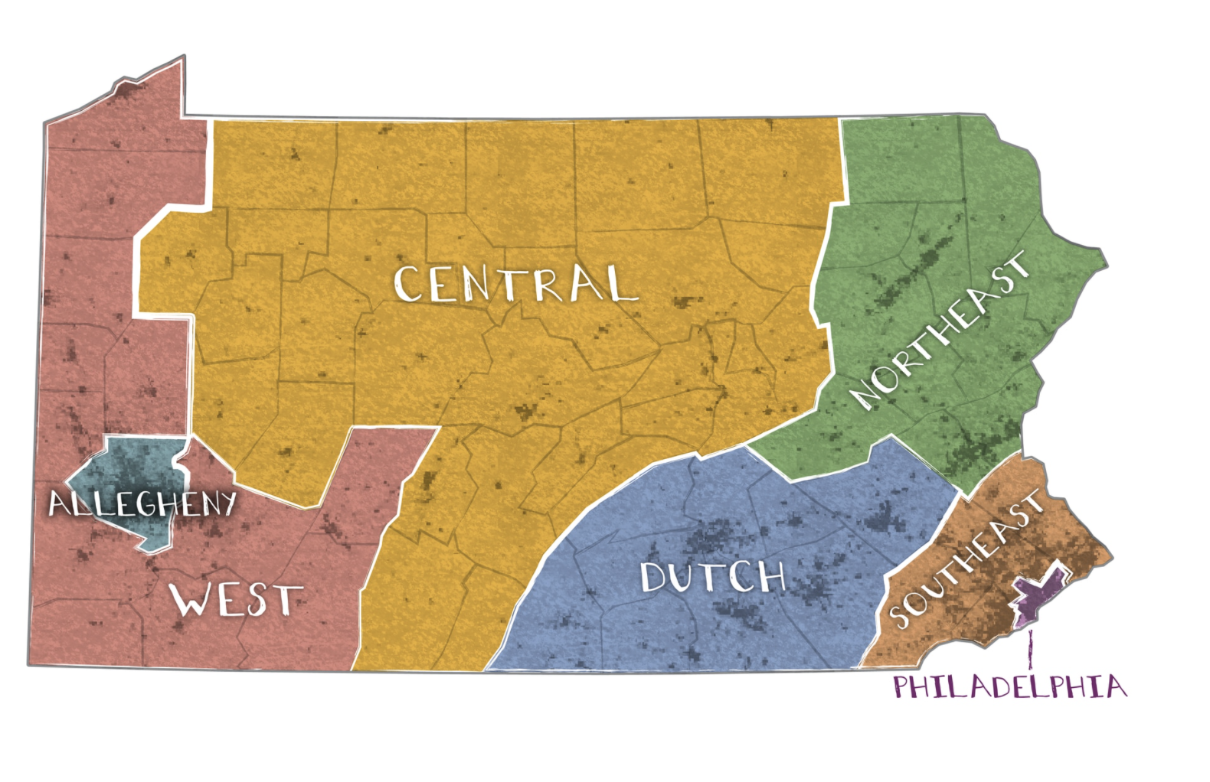
Pennsylvania at a Glance
For this analysis, we grouped Pennsylvania into areas to:
Reduce the granularity of looking at a county-by-county strategy
Capture spillover effects of popularity in an area and also be more realistic for business purposes
Source: Washington Post
Notes:
Link: https://www.washingtonpost.com/graphics/2020/politics/pennsylvania-political-geography/

Slide 6
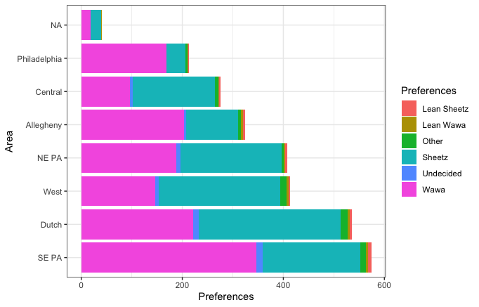
Wawa has solid support across the state
According to an April 2021 survey, Wawa is the preferred convenience store among a majority of the population in 4/7 PA regions
The survey shows that Wawa performs strongly and should keep existing operations in Southeast PA, Philadelphia, and Allegheny County
Note: “NA” means the respondent did not disclose location information. This applies to only 41 respondents.

Slide 7
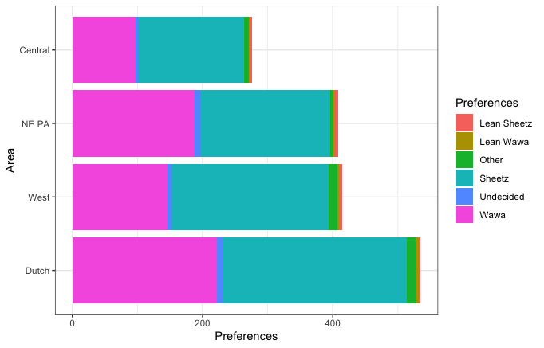
Narrow our focus to four regions
Now we need to figure out which of these regions we should consider “not worth pursuing” or “competitive”

Slide 8
Option 1: Trim
Look at the survey results in each region

Slide 9
Survey Results by Region: Central
Q: If you chose to dine at a Convenience Dining Location tomorrow, would you prefer to dine at Sheetz or Wawa (Rotated question options with lean responses)
Wawa — 35.1%
Sheetz — 58.7%
Lean Wawa — 0.4%
Lean Sheetz — 1.5%
Other — 2.5%
Undecided — 1.8%
TOPLINE:
Wawa favorability: -23.6 ppts
Undecided/Lean: 3.7%

Slide 10
Survey Results by Region: Northeast
Q: If you chose to dine at a Convenience Dining Location tomorrow, would you prefer to dine at Sheetz or Wawa (Rotated question options with lean responses)
Wawa — 46.1%
Sheetz — 48.8%
Lean Wawa — 0.7%
Lean Sheetz — 1.0%
Other — 1.2%
Undecided — 2.2%
TOPLINE:
Wawa favorability: -2.7 ppts
Undecided/Lean: 3.9%

Slide 11
Survey Results by Region: West
Q: If you chose to dine at a Convenience Dining Location tomorrow, would you prefer to dine at Sheetz or Wawa (Rotated question options with lean responses)
Wawa — 35.3%
Sheetz — 58.2%
Lean Wawa — 0.7%
Lean Sheetz — 1.0%
Other — 3.1%
Undecided — 1.7%
TOPLINE:
Wawa favorability: -22.9 ppts
Undecided/Lean: 3.4%

Slide 12
Survey Results by Region: Dutch
Q: If you chose to dine at a Convenience Dining Location tomorrow, would you prefer to dine at Sheetz or Wawa (Rotated question options with lean responses)
Wawa — 41.5%
Sheetz — 52.7%
Lean Wawa — 0.9%
Lean Sheetz — 0.6%
Other — 2.4%
Undecided — 1.9%
TOPLINE:
Wawa favorability: -11.2 ppts
Undecided/Lean: 3.4%

Slide 13
Survey-weighted population of each region
Dutch: 500
West: 396
Northeast: 388
Central: 269
Dutch is the most populous of these regions, Central is the least populous of these regions, and West and Northeast are about the same in terms of population

Slide 14
Option 1: Trim
Respondents have their minds made up: the “undecided” answer has an average 1.9% response rate in these four regions (not much wiggle room in each region).
Wawa is competitive in Dutch and Northeast: Dutch and Northeast PA are in the top three regions by population in the state and have a negative favorable rating of -2.7 and -11.2 ppts, respectively
Wawa is much less competitive in Central and West: Wawa has a worse than -20 ppts rating in Central and West; West is a populous region, but Central the least populous in the state.
With this information, I would recommend the option to cut operations in Central and West and re-allocate resources to boost sales in the Dutch and Northeast regions. Though Wawa has an unfavorable rating in each region as of April 2021, the regions are more competitive than Central and West and each has large populations that offer the potential for persuading customers.

Slide 15
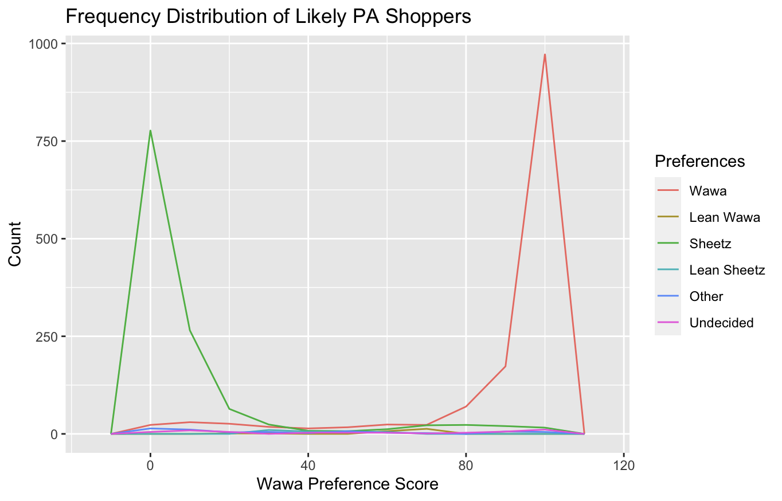
Option 2: Trial period
This graph shows the distribution of survey respondents’ scores and their likelihood to shop at Wawa
(0 <- Sheetz, Wawa -> 100)
These scores were created using our Wawa choice prediction model, which has a strong 87% accuracy rating
We want to find shoppers that fit between the two steeper slopes of the graphs in each region, because these are the shoppers that Wawa can persuade to boost sales (the voters graphed to the left and right of these arrows are very likely Sheetz or very likely Wawa shoppers)

Slide 16
We find that persuadable shoppers have prediction scores between 30 and 75
According to our analysis, persuadable shoppers generally fit in the 30-75 interval of predicted scores. We found the following potential growth percentages in the following regions:
Central: 23% potential growth
Northeast: 22% potential growth
Dutch: 17% potential growth
West: 18% potential growth

Slide 17
Remember:
Though Central has the highest potential growth percentage, it is also the least populous of these four regions. In reality, the potential growth can be summarized in the following way:
Central: 21 potential Wawa customers (of survey respondents)
Northeast: 40 potential Wawa customers (of survey respondents)
Dutch: 34 potential Wawa customers (of survey respondents)
West: 25 potential Wawa customers (of survey respondents)

Slide 18
Option 2: Trial Period
Dutch and Northeast PA offer strong potential for growth: Wawa is competitive in these regions according to choice prediction scores and there are signs of potential growth in each region among the universe of potential voters.
Central offers small potential growth to the existing Wawa customer base: While Wawa could increase its customer base by 23%, that would be only 21 new customers in the sample (an order of magnitude less than Dutch or Central after extrapolating to the whole population)
West provides the opportunity for a trial opportunity: As the third-most populous region in the state and with an 18% potential growth rate, it is worth exploring the the West region’s growth potential.
With this information, I recommend a second option: cut operations in the Central region and re-allocate resources to boost sales in the Dutch and Northeast regions. Wawa could also allocate to Southeast PA to target its 45 potential customers from the survey (representing 14% growth). With the West region’s potential for growth and its larger potential consumer base, a trial period for advertising to boost sales in the region could be worth pursuing.

Slide 19
Final Recommendations
Option 1: “Trim” — cut off marketing resources and operations in the West and Central regions of PA and re-allocate to pursue customers in the more populous Northeast and “Dutch” regions
Option 2: “Trial period” – cut off marketing resources and operations in the Central region, keep West in place and have a trial period of a certain length to see if there is a potential for growth in the West region

Slide 20
Further Research Opportunities
Research with Wawa’s operating costs and other business information to make a more informed decision
Survey to analyze customer preferences in the West region specifically
Ad message and sales deals testing — e.g. free cone/cup of Keystone Crunch for Wawa rewards members on 5/5 (Ben & Jerry’s birthday)
Notes:
Idea for Ben and Jerry’s birthday freebie deal: https://www.benjerry.com/whats-new/2021/05/birthday-sweepstakes/rules

